Slide 1

Pulse: An Adaptive Intrusion Detection for the Internet of Things
Pulse: An Adaptive Intrusion Detection for the Internet of Things
Advanced operating systems and design
-Professor Tommy Dang
By-
Aditi Misra
R11684473

Slide 2
Introduction
IOT Devices
Need for IDS
Related Work in IDS
Cyber Attacks in IOT Ecosystems
Types Of IDSs
Pulse : IDS
Methodology
Results
Future Work
References

Slide 3
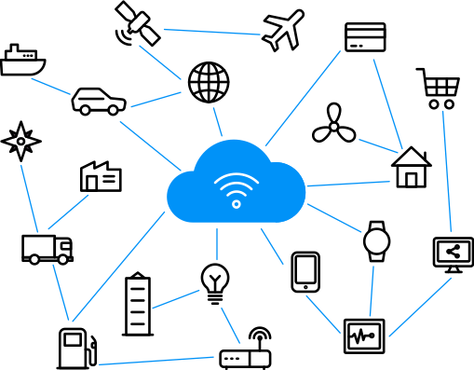
IOT devices
Interconnected every day objects with network connectivity, allowing them to send and receive data.
IoT have access to sensitive personal information such as banking information, usernames, passwords, etc.
Variety of IoT designed for different applications (fitness, smart home, etc.)

Slide 4
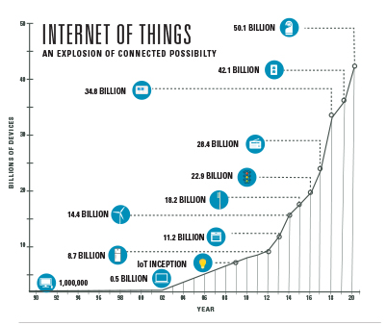
Need for IDSs
The number of diverse inter connected Internet of Things (IoT) devices keeps increasing exponentially, introducing new security and privacy challenges.
Given that smart devices are vulnerable to a variety of attacks, they can be considered to be the weakest link for breaking into a secure infrastructure.
For instance, IoT devices have recently been employed as part of botnets, such as Mirai, and have launched several of the largest Distributed Denial of Service (DDoS) and spam attacks in history.

Slide 5
Related Work in IDSs
IDSs for Wireless Sensor Networks and Traditional IT
T
The IDSs , initially, were designed for Wireless sensor networks or conventional IT Infrastructure but none of these systems ﬁt the speciﬁcations of the IPv6 connected IoT devices because of significant architecture differences.
IDSs designed for traditional IT systems have not considered the scale, heterogeneity, use cases, or device/vendor constraints that come in an IoT ecosystem.
IDSs for IoT
All the existing IDSs come with limitations such as they only address speciﬁc attacks, they are rule-based and as a result they are not adaptable, or they are based on simulations and have not been validated against a real IoT environment.

Slide 6
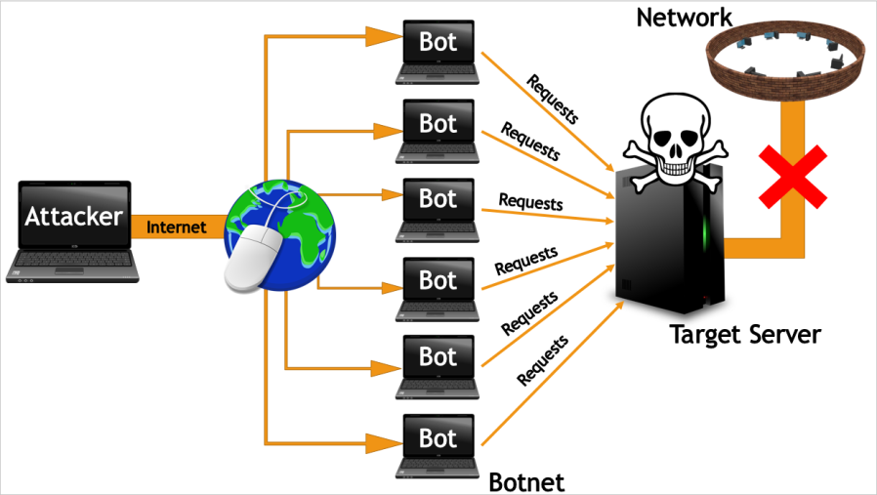
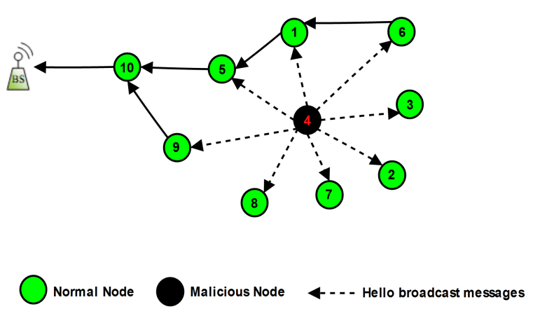
Cyber Attacks in IOT Ecosystems
During Denial of Service attack, the devices/resources are no longer available to legitimate users.
In Hello Flood Attack an IoT network, a routing protocol broadcasts a hello message in order to declare its presence to its neighbour nodes.

Slide 7
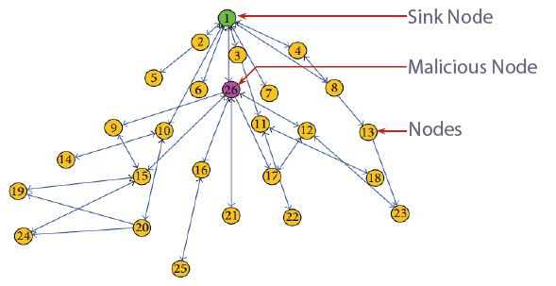
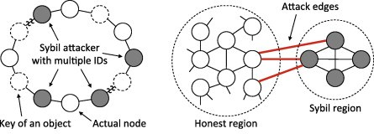
Cyber Attacks in IOT Ecosystems cntd…
During Sinkhole Attack attack, a malicious IoT node will attempt to attract all the network trafﬁc from its neighbour nodes towards it.
During Sybil attack, a node appears to have multiple identities. The routing protocol, the detection algorithm, and co-operation process can be attacked by this malicious node.

Slide 8
Types of IDSs
IDSs are built based on the same concept of collecting data from the network , analyzing data to identify attacks and reporting the attacks to the network administrator. The difference among IDSs lie in their implementation approach such as :
Data source: host-based, network-based, hybrid
Detection Method: signature-based, anomaly-based
Time of Detection: offline, online
Architecture: centralised, distributed
Networking Type: wired/wireless, ad-hoc, etc

Slide 9
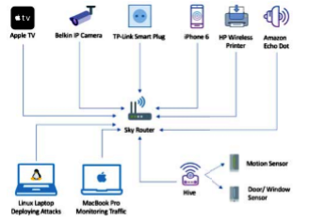
Pulse : IDS
A novel predictive model that can identify malicious IoT nodes in a network based on their network activity.
The model consists of two components:
  a) The first component is based on a Machine Learning (ML) approach (learns the networking behavior of the IoT-based network).
  b) The second component is a rule based approach, which is established from a security policy configured by the network administrator.
The combination of these components creates an adaptive and flexible model, which accurately detects malicious IoT devices in the network

Slide 10
Methodology
IoT Smart Home Testbed
To initiate the development of Pulse, a smart home based IoT testbed was built because of two reasons; (a) in order to collect data from real IoT devices and (b) to create a realistic environment which will allow to evaluate the feasibility of our system. It also consisted of two traditional IT devices. One of them constantly recorded the network trafﬁc and automatically generated and saved the log ﬁles. The other was used to deploy various attacks.
Generating Data
Two data-sets were generated , one with benign network trafﬁc and one with malicious, to train the ML model of our system we monitored the network trafﬁc on the IoT testbed for four consecutive days using the software Wireshark. For the ﬁrst two days, we recorded and observed how the network operated under normal conditions. For the next two days, we randomly deployed attacks while the trafﬁc was still being recorded.

Slide 11
Methodology
Machine Learning Model
This paper aimed at creating an IDS that will automatically learn its ecosystem machine learning.
The data log generated earlier formed the basis for the feature vectors. These feature vectors consisted of: the time of the attack, the destination IP address of the devices, etc and were subsequently amended with their class label, i.e. benign or malicious.
We used Wekas inbuilt function, a popular suite of ML tools, to sub-sample an even number of both classes.
To determine the best classiﬁcation model for this case, we performed 10-fold cross validation experiments by applying a variety of classiﬁers distributed as part of Weka. A Naive Bayes classiﬁer outperformed other methods.

Slide 12
Results
The results from our initial experiments demonstrated that our model was effective at identifying network probing and SYN/UDP ﬂood attacks.
In future we will use more theoretical reasoning to devise new features that represent network behaviours and enable to reason around the effective behaviours to monitor for attack detection in diverse IOT environments.
Attack | Precision | Recall | F-measure
Quick/ Quick Plus scan | 97.7 | 97.7 | 97.7
Regular/Intense Scan | 95.5 | 95.5 | 95.5
SYN Flood | 80.8 | 68.8 | 65.8
UDP Flood | 81 | 68.8 | 65.8

Slide 13
Future Work
Although our results are very promising there are still a lot of elements and parameters that we need to consider to fully develop Pulse.
We need to consider clustering homogeneous devices together and deriving a normal trafﬁc behaviour for every cluster to aid in detecting abnormalities on network and also malicious nodes.
Furthermore, we need to perform signiﬁcantly more attacks, and speciﬁcally focus on the ones mentioned earlier on in the paper.
Additionally, we would like to also consider other features for the ML training such as Payload, Ingoing/Outgoing ratio, etc.
Finally, we need to develop the rule-based algorithm.

Slide 14
References
https://ieeexplore.ieee.org/document/8379722
Eirini Anthi, Amir Javed, Omer Rana, and George Theodorakopoulos. Secure data sharing and analysis in cloud-based energy management systems. In Cloud Infrastructures, Services, and IoT Systems for Smart Cities, pages 228–242. Springer, 2017.
Daniele Midi, Antonino Rullo, Anand Mudgerikar, and Elisa Bertino. Kalisa system for knowledge driven adaptable intrusion detection for the internet of things. In Distributed Computing Systems (ICDCS), 2017 IEEE 37th International Conference on, pages 656–666. IEEE, 2017.
Daniel Miessler. Hp study reveals 70 percent of internet of things devices vulnerable to attack. Retrieved June, 30:2015, 2014.
Pavan Pongle and Gurunath Chavan. Real time intrusion and wormhole attack detection in internet of things. International Journal of Computer Applications, 121(9), 2015.
Kathy Pretz. Exploring the impact of the internet of things: A new ieee group is taking on the quest to connect everything. The Institute, 2013.

Slide 15


Slide 16
Thankyou !!

